Slide 1


DATA STRUCTURES AND ALGORITHM PRINTER JOB
PRESENTED BY
JEEVAN BAABU MURUGAN (RA2211026010548)
JACK WAGHAN (RA2211026010546)
ASHIK JOEL(RA2211026010563)

Slide 2
Queue Implementation
PROBLEM STATEMENT: Printer Job Queue Management System
Objective: Illustrate a simplified print job queue management system.
Data Structures: Use struct PrintJob for print jobs and struct PrintQueue for the queue.

Slide 3
Algorithm for Print Job Queue Management
Initialization:
Initialize front and rear pointers to -1.
Queue Status:
isEmpty: Check if the queue is empty.
isFull: Check if the queue is full (circular queue).
Enqueue:
Add a new print job to the queue.
Check for queue fullness.
Update front and rear pointers (considering circular wrapping).
Dequeue:
Remove the next print job from the queue.
Check for an empty queue.
Update front and rear pointers (considering the circular nature).

Slide 4
Working of the System
Initialization:
Initialize the print queue with front and rear pointers set to -1.
Queue Status:
isEmpty checks if the queue is empty.
isFull checks if the queue is full (using a circular queue concept).
Enqueue a Print Job:
The enqueue function adds jobs to the queue.
Checks for queue fullness.
Updates front and rear pointers, considering circular wrapping.
Dequeue a Print Job:
The dequeue function removes jobs from the queue.
Checks for an empty queue.
Updates front and rear pointers, considering the circular nature.
Main Function:
Creates a print queue, initializes it.
Adds jobs to the queue.
Simulates printing by dequeuing jobs.

Slide 5
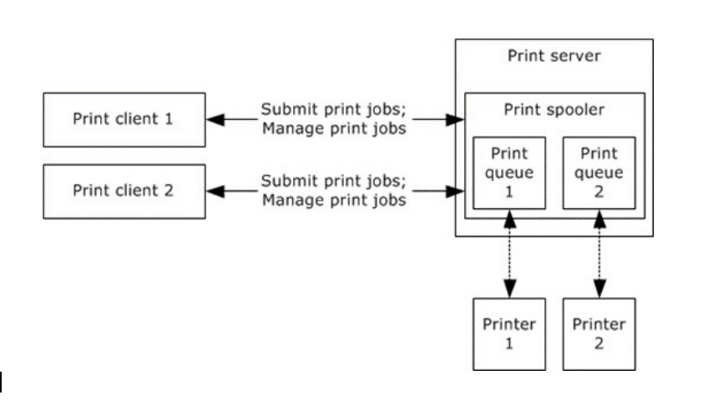
Printer Job , utilizing Queue works. In modern workplaces, reliance on networked printers for document processing is ubiquitous. However, the management of print jobs within these systems often poses significant challenges, impacting the overall efficiency, security, and cost- effectiveness of printing operations . the current state of printer job queue management systems falls short in addressing critical aspects of efficiency, security, and resource optimization. These challenges underline the necessity for a comprehensive solution that intelligently prioritizes print jobs, optimizes resource allocation, implements robust security measures, and provides administrators with the tools to track, analyze, and improve printing operations within an organization.

Slide 6
CODE
#include <stdio.h>
#include <stdlib.h>
#include <stdbool.h>
#define MAX_QUEUE_SIZE 100
// Define a structure for a print job
struct PrintJob {
int jobNumber;
char document[50]; // Assuming document names are less than 50 characters};
// Define a structure for a print job queue
struct PrintQueue {
struct PrintJob jobs[MAX_QUEUE_SIZE];
int front, rear;};
// Initialize the print job queue
void initialize(struct PrintQueue* queue) {
queue->front = queue->rear = -1;}
// Check if the print job queue is empty
bool isEmpty(struct PrintQueue* queue) {
return (queue->front == -1);}
// Check if the print job queue is full
bool isFull(struct PrintQueue* queue) {
return ((queue->front == 0 && queue->rear == MAX_QUEUE_SIZE - 1) || (queue->front == queue->rear + 1));}
// Enqueue a print job into the print job queue
void enqueue(struct PrintQueue* queue, struct PrintJob job) {
if (isFull(queue)) {
printf("Print queue is full. Cannot add job #%d: %s\n", job.jobNumber, job.document);
} else {
if (isEmpty(queue)) {
queue->front = queue->rear = 0;
} else {
queue->rear = (queue->rear + 1) % MAX_QUEUE_SIZE;
}
queue->jobs[queue->rear] = job;
printf("Job #%d: %s added to the print queue\n", job.jobNumber, job.document);}}
// Dequeue a print job from the print job queue
void dequeue(struct PrintQueue* queue) {
if (isEmpty(queue)) {
printf("Print queue is empty. No jobs to dequeue.\n");
} else {
printf("Job #%d: %s has been printed and removed from the queue\n", queue->jobs[queue->front].jobNumber, queue->jobs[queue->front].document);
if (queue->front == queue->rear) {
// Last job in the queue
queue->front = queue->rear = -1;
} else {
queue->front = (queue->front + 1) % MAX_QUEUE_SIZE;}}}
int main() {
struct PrintQueue printQueue;
initialize(&printQueue);
struct PrintJob job1 = {1, "Document1.txt"};
struct PrintJob job2 = {2, "Document2.pdf"};
struct PrintJob job3 = {3, "Document3.doc"};
enqueue(&printQueue, job1);
enqueue(&printQueue, job2);
enqueue(&printQueue, job3);
dequeue(&printQueue);
dequeue(&printQueue);
return 0;
}

Slide 7
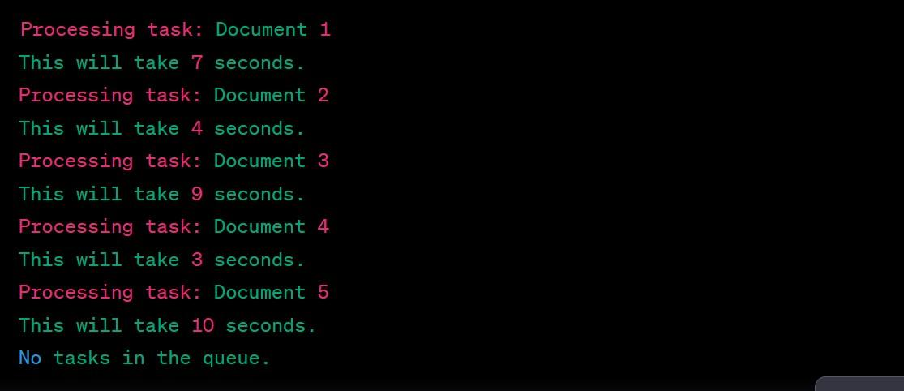
OUTPUT

